Slide 1
Open Data & Libraries
Open Data Literacy Project
Washington State Library, Summer 2018
Kathleen Sullivan, intern

Slide 2
Research questions
What open data activities are Washington State public libraries engaged in? What activities would they like to undertake in the future?
How might the Washington State Library support public libraries’ open data activities?
How many Washington State localities now publish open data?

Slide 3
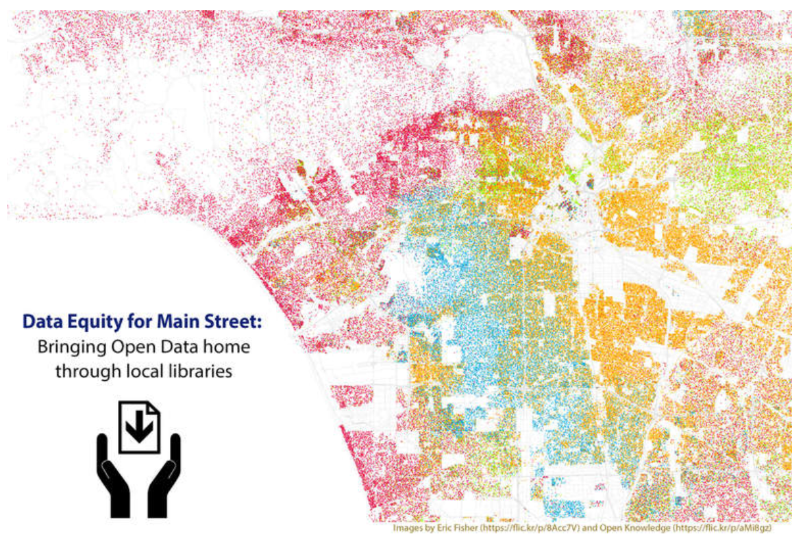
Methods
Interviewed staff from 10 libraries participating in Data Equity for Main Street (7 in WA, 3 in CA)
Interviewed or reviewed websites of 12 other Washington State public library systems
Asked about service populations, and whether libraries published, taught or advised local agencies about open data

Slide 4
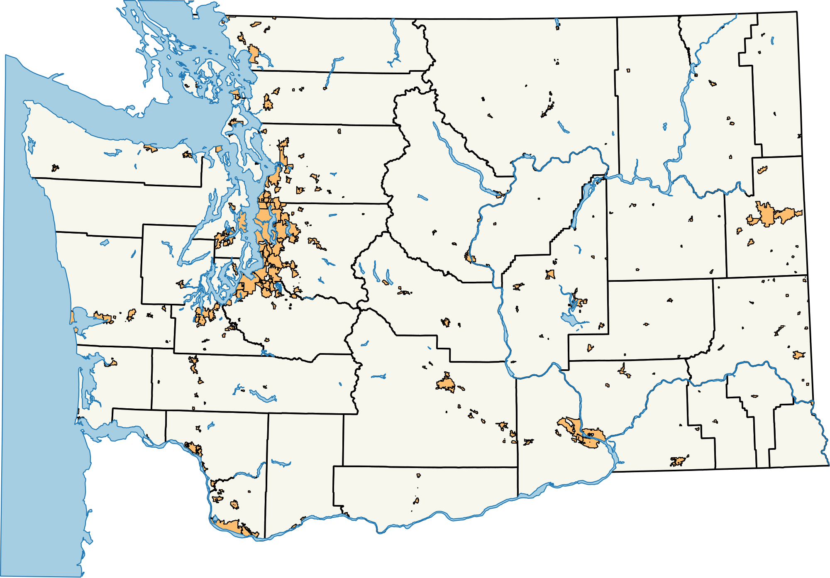
I also surveyed local open data publishing
Washington State’s 39 counties + largest city in each county

Slide 5
Findings: Libraries as advisors
Two Washington State public libraries are working with city governments to launch or improve open data.
One large California public library already works with its city on education, emergency planning and digital privacy, and intends to work with the city to improve its open data portal.
Five other library systems expressed interest in working with local government on open data, or even providing open data portals themselves.

Slide 6
Findings: What makes libraries natural open data advisors?
Culture friendly to technology and open information practices
Lots of experience leveraging data to demonstrate value
User experience experts: Librarians understand how real people use information, especially online

Slide 7
Findings: Libraries as educators
8 of libraries contacted have conducted open data classes for the general public
3 others are planning classes before the end of 2018.
Another 7 used the curriculum to train staff
One used curriculum to educate local publishing agencies

Slide 8
Findings: What went well with public open data classes
Overall positive feedback
Content is solid and can be tailored to particular audiences
Strong connection to library mission – access, literacy, critical thinking, participation in democratic process
Lays a foundation for curiosity, innovation
Good for planning: Thriving libraries explore new tools

Slide 9
Findings: Challenges in public open data classes
Attendance, even after vigorous outreach
Some librarians wondered if better available open data would boost interest and literacy efforts

Slide 10
Findings: Open data staff training a home run
High attendance & enthusiasm
Informal signs of continued use – emails, requests for more classes
Widespread agreement that reference librarians should be trained and ready to direct patrons to open data one-on-one, as needed.
…and librarians also use open data curriculum to work with local publishing agencies

Slide 11
Findings: Which users most need open data?
Librarians interviewed believed open data was an especially good resource for users who,
Have a question that can’t be answered by other sources. They need to build the information themselves.
Want to inspect the data behind an assertion.
Want to analyze, manipulate and visualize data themselves.

Slide 12
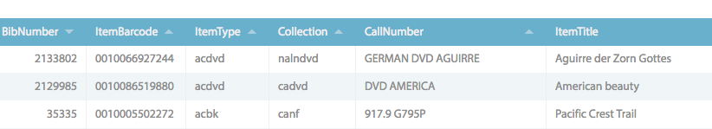
Findings: Libraries as publishers
Just one of the libraries contacted is currently publishing open datasets
Another library’s archive publishes historical documents
Libraries face the same challenges as any other publisher – time constraints, privacy and security concerns, anxiety about misinterpretation

Slide 13
Findings: Local open data is thin
27 of 39 counties publish open data of some kind
10 of 39 cities surveyed publish some kind of open data
Overwhelmingly GIS, and most presented in DIY formats
Only 6 localities were publishing anything other than maps and parcel information

Slide 14
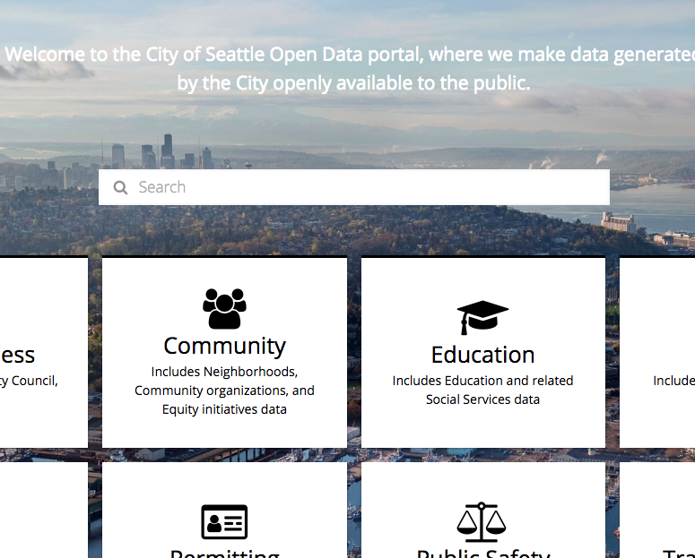
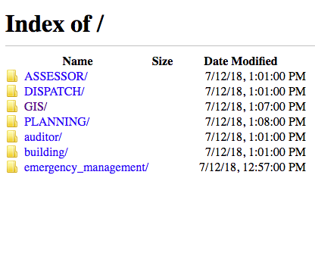
Findings: Local open data presentation ranges
from this…
…to this

Slide 15
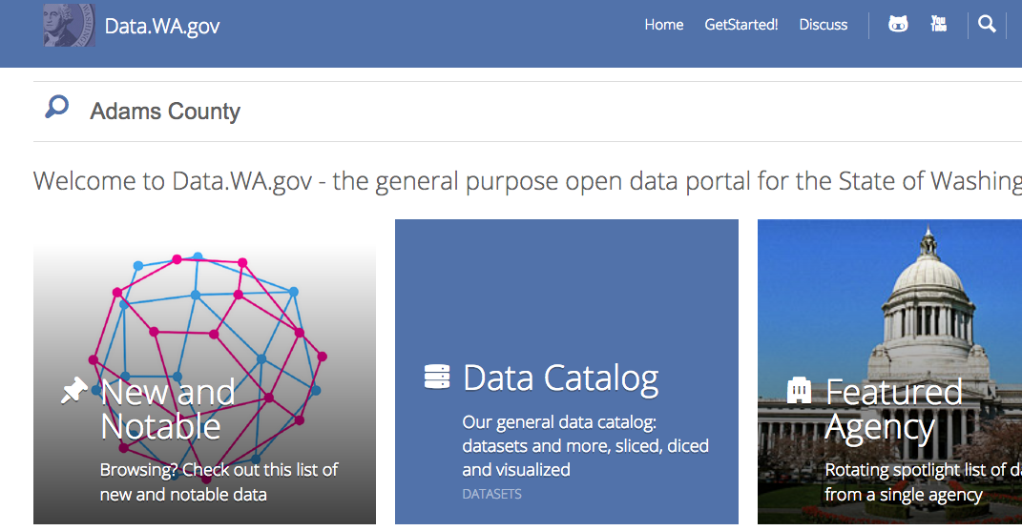
Findings: You can still find data about localities, just not from localities themselves

Slide 16
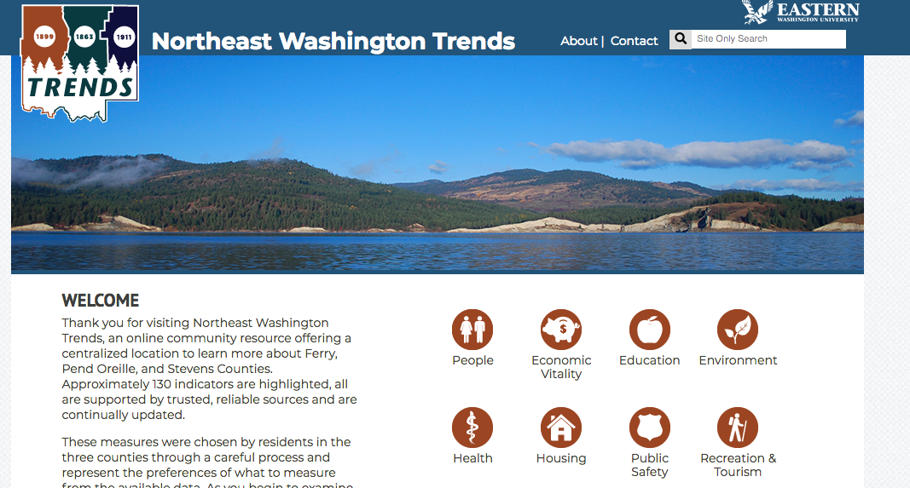
Findings: Other data sources for localities

Slide 17
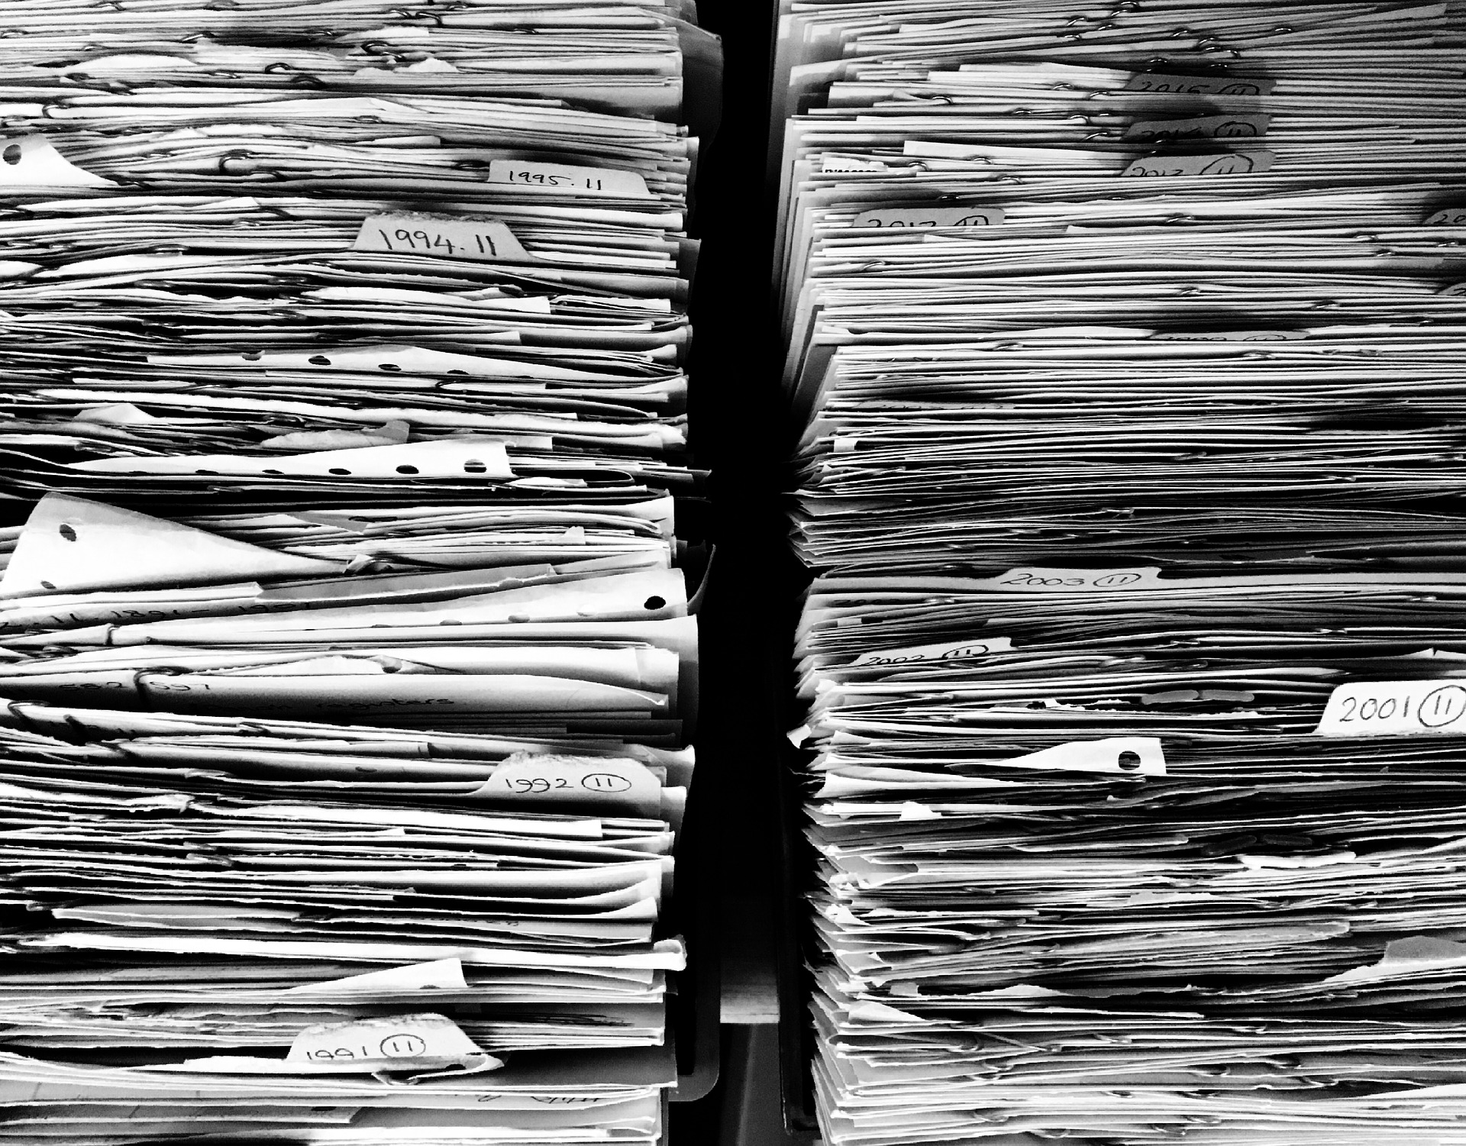
Findings: Many localities still working on basic info management
Recent records management grants through the Washington State Archives showed,
Two thirds of applicants just wanted to inventory paper records, or get them off the floor.
When localities ask for technology, it’s most often for software to manage the records requests – not get the records themselves online.

Slide 18
Recommendations: Provide the platform
The State Library should explore options for providing a state platform for local open data publishing
This eliminates a major roadblock and frees up libraries to work with governments on publishing high-quality data that the public wants

Slide 19
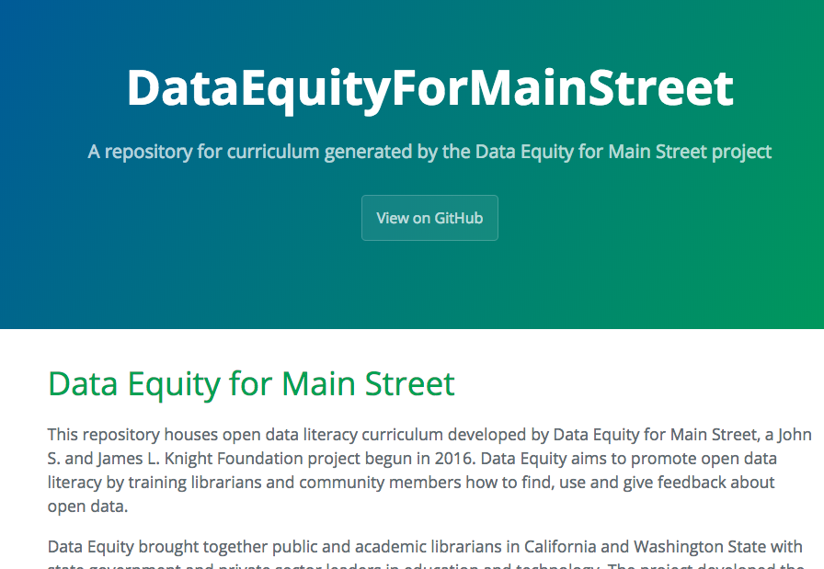
Recommendations: Create open data resource guide
Create a Lib Guide, a one-stop resource for curriculum, toolkits, collections of high-quality open data and tips about how to get started with open data publishing, use, instruction and advising.
Help develop e-curriculum that can be embedded in a library site or open portal.
Visit areas where libraries work closely with local agencies, or where local agencies are trying to work openly.

Slide 20
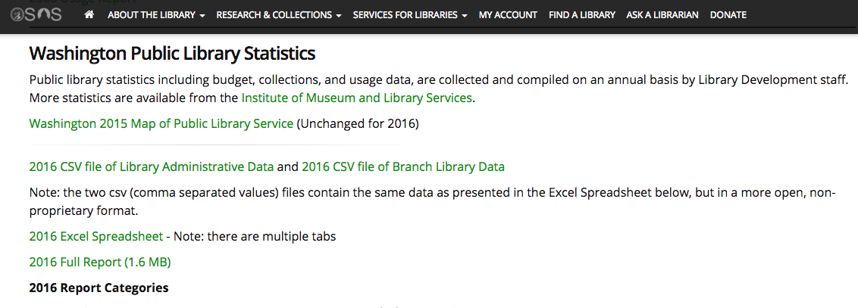
The State Library has already raised its game

Slide 21
Questions?
Read the report and view supporting materials at my GitHub repository:
https://github.com/OpenDataLiteracy/WA-State-Library-2018
Contact Kathleen Sullivan: kesullivan591@gmail.com

